Slide 1
Actual Tutorial 2
By Jeremy Lim (Based on slides by Jeremy Choo, 18/19 Sem 1 TA)

Slide 2
If you are not from one of my tuts
Remember to mark attendance
You will get a copy of this week’s slides also ☺

Slide 3
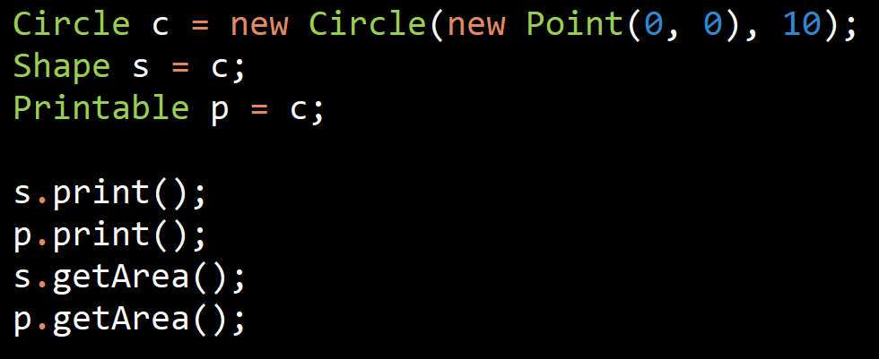
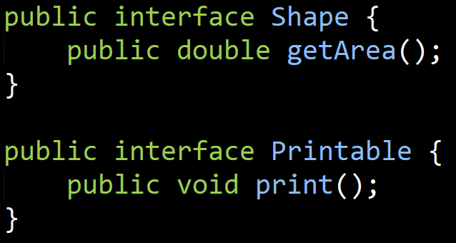
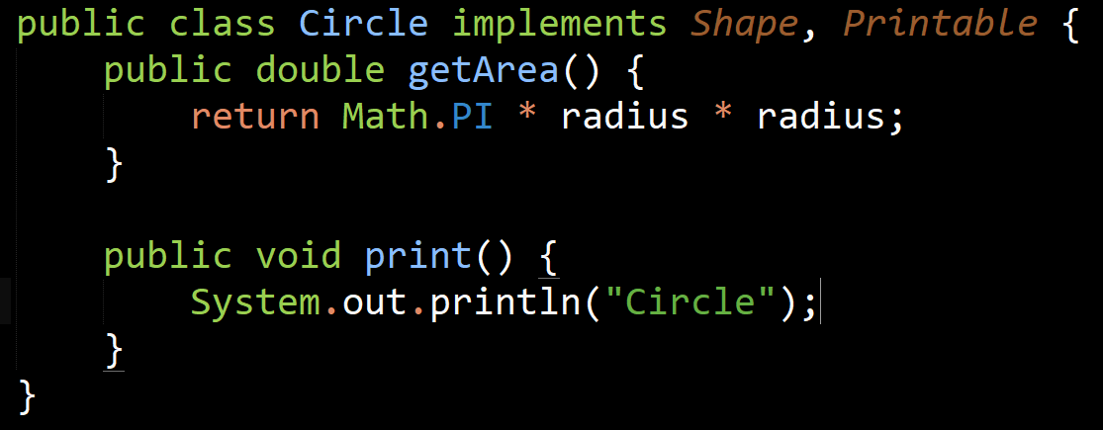
Q1
Are the following statements allowed?

Slide 4
Q1
Are the following statements allowed?
Circle Methods
getArea
print
Circle Implementation
getArea
print
Printable Methods
print
Interfaces have no implementation
Shape Methods
getArea

Slide 5
Q1
Are the following statements allowed?
No
Circle Methods
getArea
print
Circle Implementation
getArea
print
Printable Methods
print
Interfaces have no implementation
Shape Methods
getArea
(no print)

Slide 6
Q1
Are the following statements allowed?
No
Yes
Circle Methods
getArea
print
Circle Implementation
getArea
print
Printable Methods
print
Interfaces have no implementation
Shape Methods
getArea

Slide 7
Q1
Are the following statements allowed?
No
Yes
Yes
Circle Methods
getArea
print
Circle Implementation
getArea
print
Printable Methods
print
Interfaces have no implementation
Shape Methods
getArea

Slide 8
Q1
Are the following statements allowed?
No
Yes
Yes
No
Circle Methods
getArea
print
Circle Implementation
getArea
print
Printable Methods
print
Interfaces have no implementation
Shape Methods
getArea

Slide 9
Q1b
What if we change from interfaces to abstract class?

Slide 10
Q1b
What if we change Shape and Printable from interfaces to abstract class?
Cannot.
Can only extend from 1 class.

Slide 11
Q1c
Can we define a new interface PrintableShape?

Slide 12
Q1c
Can we define a new interface PrintableShape?
Yes. Interfaces can inherit from multiple parent interfaces.
Not from classes

Slide 13
Interface use case
A
B
Class A uses B
i.e. something like public A(B b) { this.b = b; }
… this.b.f() somewhere in the code
Constructor accepts an instance of B

Slide 14
Interface use case
Constructor accepts an instance of I
A
Interface
I
Class A uses I
B implements I
B

Slide 15
Interface use case
A can use any of B, C, D without touching the code in A
More maintainable, easier to swap classes
A
Interface
I
Class A uses I
B, C, D implements I
D
C
B

Slide 16
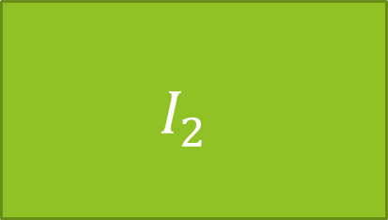
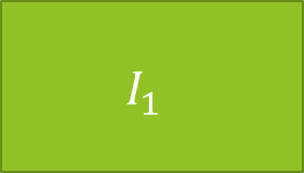

Interface use case
$$I_{1}$$
$$I_{2}$$
$$I_{3}$$
A implements multiple interfaces
A

Slide 17
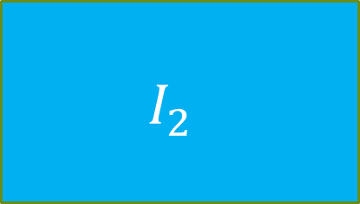
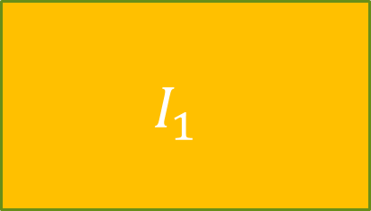
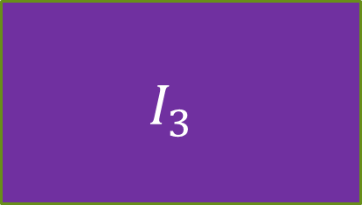
Interface use case
Can choose a subset of methods to use, because sometimes you don’t need all
$$I_{1}$$
$$I_{2}$$
$$I_{3}$$
A implements multiple interfaces
A

Slide 18
Interface use case
Example: LinkedList implements List, Queue
If you only need a queue (Add to head, remove from tail), you don’t care about what is in the middle
You could just use LinkedList directly
But harder for someone else to understand your code
What if a better performing queue than LinkedList is added?
Have to change every usage of LinkedList to NewQueue
Instead of just changing Queue<Item> queue = new LinkedList() to new NewQueue()

Slide 19
Key points
Flexibility
Maintainability
Understandability

Slide 20
Q2
Write a class Rectangle that implements Shape and Printable, using bottom-left and top-right points. Handle the case where the two points do not define a proper rectangle.
topRight
✅
bottomLeft

Slide 21
Q2
Write a class Rectangle that implements Shape and Printable, using bottom-left and top-right points. Handle the case where the two points do not define a proper rectangle.
bottomLeft
❌
topRight

Slide 22
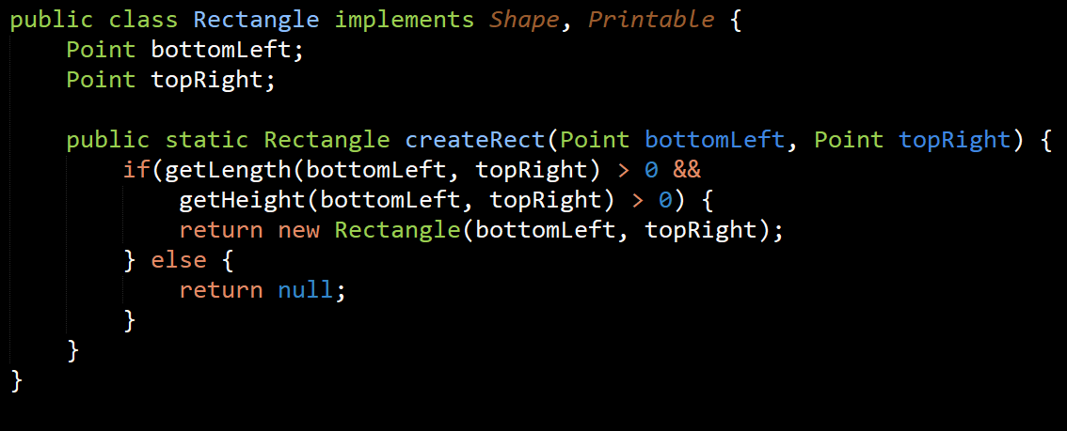
Q2
Write a class Rectangle that implements Shape and Printable, using bottom-left and top-right points. Handle the case where the two points do not define a proper rectangle.
Don’t directly create a Rectangle, use a static method to check constraints

Slide 23
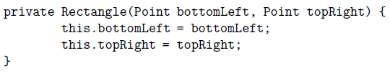
Q2
Write a class Rectangle that implements Shape and Printable, using bottom-left and top-right points. Handle the case where the two points do not define a proper rectangle.
Force creation using the static method
Don’t directly create a Rectangle, use a static method to check constraints

Slide 24
Q2
Write a class Rectangle that implements Shape and Printable, using bottom-left and top-right points. Handle the case where the two points do not define a proper rectangle.
Force creation using the static method
Don’t directly create a Rectangle, use a static method to check constraints Alt: Throw exception in constructor
Specifically IllegalArgumentException

Slide 25
Java API Exceptions
https://docs.oracle.com/javase/9/docs/api/java/lang/Exception.html
https://docs.oracle.com/javase/9/docs/api/java/lang/RuntimeException.html

Slide 26
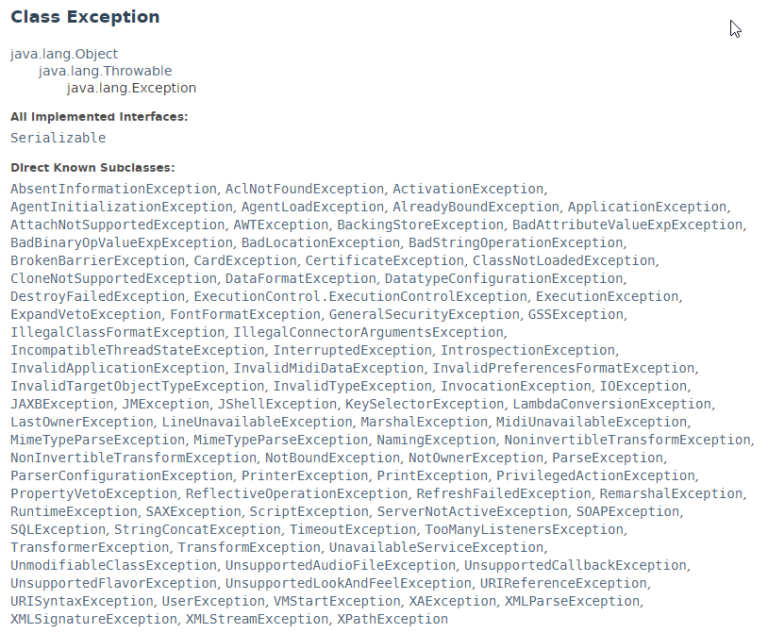
Java API Exceptions
https://docs.oracle.com/javase/9/docs/api/java/lang/Exception.html
https://docs.oracle.com/javase/9/docs/api/java/lang/RuntimeException.html

Slide 27
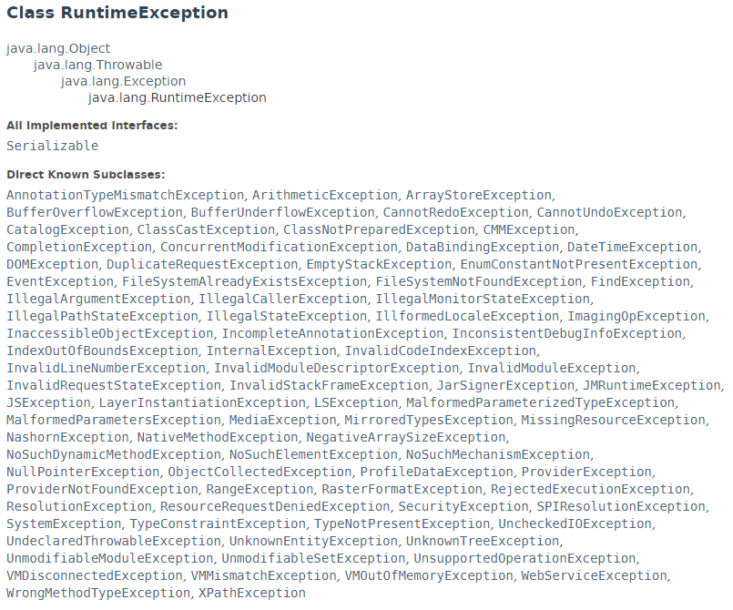
Java API Exceptions
https://docs.oracle.com/javase/9/docs/api/java/lang/Exception.html
https://docs.oracle.com/javase/9/docs/api/java/lang/RuntimeException.html

Slide 28
Java API Exceptions
https://docs.oracle.com/javase/9/docs/api/java/lang/Exception.html
https://docs.oracle.com/javase/9/docs/api/java/lang/RuntimeException.html
Generally: Choose exception that best suits our use case
Exception class: “Checked exceptions” - force program to handle a possible exception
Have to use a try { } catch { }
Most common: file I/O (IOException)
RuntimeException class: mainly constraint/input checking
Method cannot tell if a parameter is wrong until runtime
Common: IllegalArgumentException, NullPointerException, NoSuchElementException, RangeException

Slide 29
Q3
Try it yourself ☺ (Like a mini-lab)

Slide 30
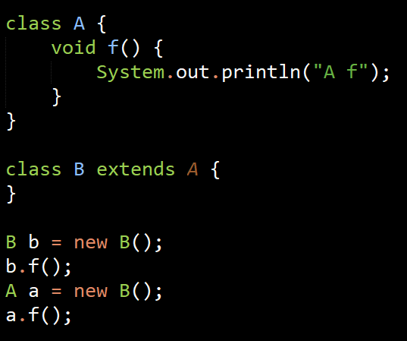
Q4a: Any errors?
A Mtds
f
A Impl
f
B Mtds
f
B Impl

Slide 31
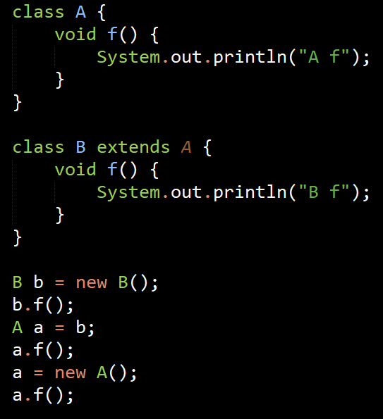
Q4b: Any errors?
A Mtds
f
A Impl
f
B Mtds
f
B Impl
f

Slide 32
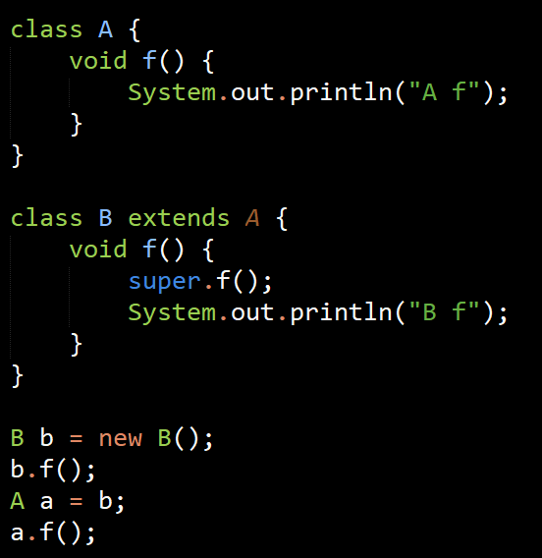
Q4c: Any errors?
A Mtds
f
A Impl
f
B Mtds
f
B Impl
f
Output: A f
B f
Output: A f
B f

Slide 33
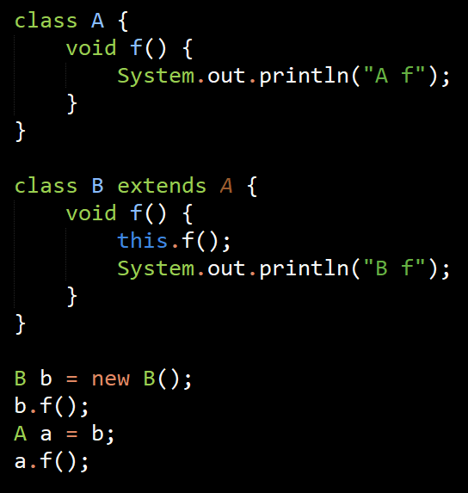
Q4d: Any errors?
A Mtds
f
A Impl
f
B Mtds
f
B Impl
f
Can compile but infinite loop

Slide 34
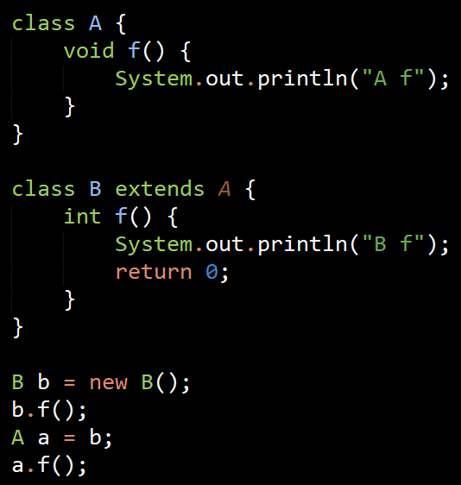
Q4e: Any errors?
A Mtds
f(): void
B Mtds
f(): void
f(): int

Slide 35
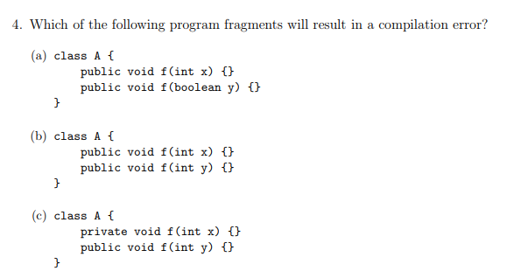
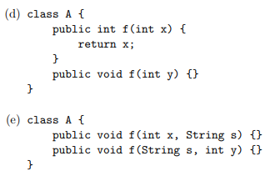
Flashback Tutorial 1 Q4
Considered: Name, return type, input parameters (type, number, order)
Error Can’t decide what to return
Error f(int) = f(int)
Error Can’t decide which to use

Slide 36
Q4e: Any errors?
A Mtds
f(): void
B Mtds
f(): void
f(): int
Can’t decide what to return

Slide 37
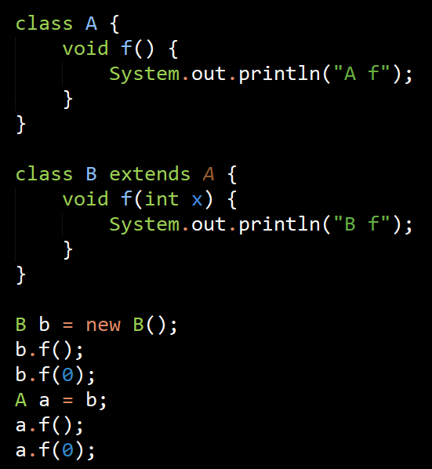
Q4f: Any errors?
A Mtds
f
A Impl
f
B Mtds
f
f(int)
B Impl
f(int)

Slide 38
Q4f: Any errors?
A Mtds
f
A Impl
f
B Mtds
f
f(int)
B Impl
f(int)
Not allowed

Slide 39
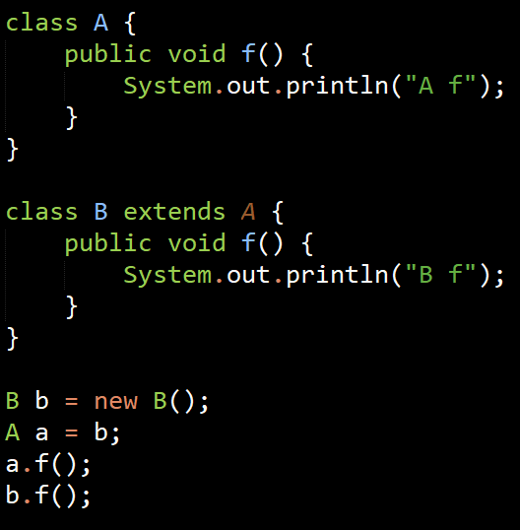
Q4g: Any errors?
A Mtds
f
A Impl
f
B Mtds
f
B Impl
f

Slide 40
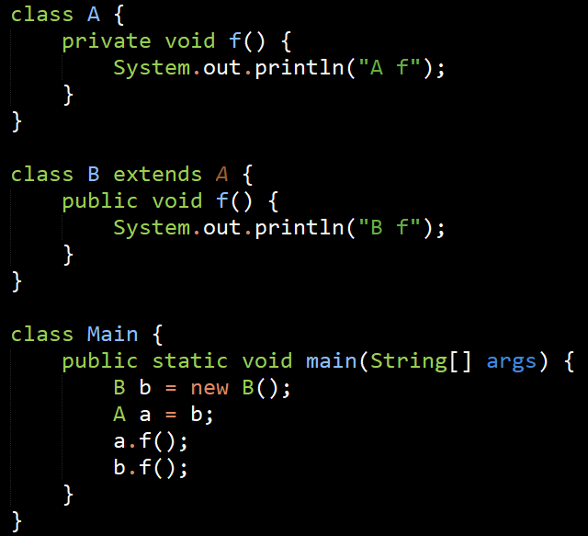
Q4h: Any errors?
Private access, B cannot override

Slide 41
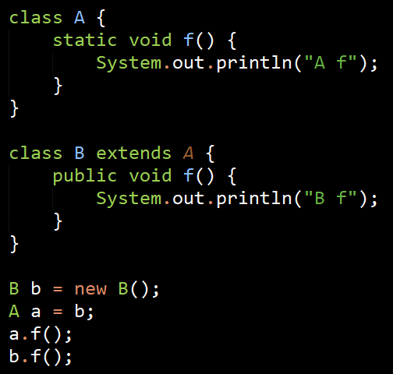
Q4i: Any errors?
Non-static cannot override static

Slide 42
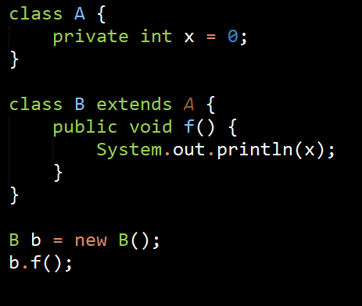
Q4j (static override static) is OK. Q4k: Any errors?
Accessing private variable from another class

Slide 43
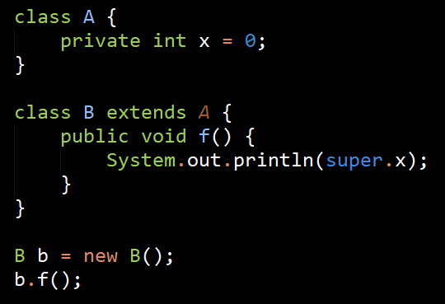
Q4l: Any errors?
Proper way to access private variables:
Within the class A:
Protected int getX() {
return this.x;
}
Within B.f():
System.out.println(getX());
Accessing private variable from another class

Slide 44
M, N, O
Protected can be accessed from subclass.
All OK.

Slide 45
Hopefully you now understand
Polymorphism / Dynamic Binding
Interfaces (See slides sent last week also)

